Slide 1
Performance comparison for skin cancer detection using CNN and transformer based approach
Group No - 19
Abu Bakar Hasnath - 20301037
Adib Faisal Shahriar - 20301020
Sayad Muhammad - 20101356
Ar-Rafi Islam - 20301164
Tanzir Hossain Shrizon - 20301154

Slide 2
Table of Contents
Introduction
Motivation
Existing Work
Our Goal
Dataset
Proposed Methodology
Limitation

Slide 3
Introduction
The most prevalent type of cancer, skin cancer, is caused by uncontrollably growing skin cells. The main cause of skin cancer are overexposure to ultraviolet(UV) light from the sun or any artificial source.
The deadly complications from skin cancer can be decreased by adequate therapy following early diagnosis

Slide 4
Motivation
Skin lesions present diverse abnormalities requiring accurate identification and prompt treatment, posing challenges to healthcare providers.
Recent progress in machine learning, especially in medical image analysis, has shown promise in automating skin lesion detection and categorization.
Early and precise identification of skin lesions is critical for timely diagnosis and treatment, preventing disease progression and improving patient outcomes.
Leveraging machine learning techniques can lead to the development of precise diagnostic tools beneficial for both healthcare professionals and patients.
On device machine learning can help medical practitioners in their work

Slide 5
Existing work
Previous studies have explored the combined use of deep learning and machine learning algorithms for skin cancer detection, achieving high accuracy rates.
Researchers have proposed innovative deep learning models, such as Inception-ResNetv2 and MobileNet, for skin cancer detection, achieving impressive classification accuracies.
Studies highlight growing concerns about outbreaks of skin diseases like monkeypox, emphasizing the need for accurate diagnostic tools to combat such health threats.
Deep neural networks have been compared with dermatologists, showing comparable performance in skin lesion classification, indicating the potential of machine learning in medical diagnostics.

Slide 6
Our Goal
Propose an exhaustive approach for skin lesion detection and classification using machine learning methodologies.
Analyze the efficiency of machine learning algorithms using the HAM10000 dataset, comprising 10,000 images of various pigmented skin lesions.
Assess the performance of leading-edge machine learning techniques like CNN in detecting and classifying skin lesions.
Study the effectiveness of transformed based architecture to classify skin cancer from image data
Demonstrate the potential of machine learning in dermatology by generating precise diagnostic instruments beneficial for healthcare professionals and patients.
Contribute to improving health outcomes by enabling early recognition processes and personalized therapeutics for effective treatment of skin lesions.

Slide 7
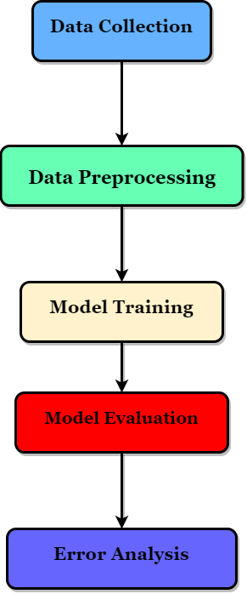
Workflow
5

Slide 8
Dataset
3307 Benign skin lesions
6693 Malignant skin lesions
Gathered from dermatology clinics and medical imaging sources
Contains images with diverse characteristics, sizes, and patient demographics
Aimed at facilitating research in dermatology and medical image analysis
Publicly available for academic and research purposes

Slide 9
Proposed Methodology
Run state of the art pre Trained CNN architecture
VGG16
ResNet50
Inceptionv3
inceptionResNetv2
Vision transformer
Custom proposed CNN architecture with low number of parameters
Custom proposed transformer based architecture
Compare performance of these architectures
Use explainable AI to evaluate the results

Slide 10
Limitation/ Challenges
Potential bias in the dataset due to collection from specific dermatology clinics and medical imaging sources, which may not represent the full diversity of skin lesions seen in the general population.
Challenges in ensuring consistent and accurate labeling of skin lesions, as diagnosis can be subjective and dependent on the expertise of the healthcare providers.
Difficulty in generalizing the machine learning models to real-world clinical settings, where the characteristics of skin lesions may differ from the training data.
Potential for reduced performance in detecting rare or atypical skin lesions, as the dataset may not have sufficient representation of these types of lesions.
Concerns about the interpretability and explainability of deep learning models, which can act as "black boxes," making it challenging to understand the decision-making process.

